Slide 1

Metallic Bonding

Slide 2
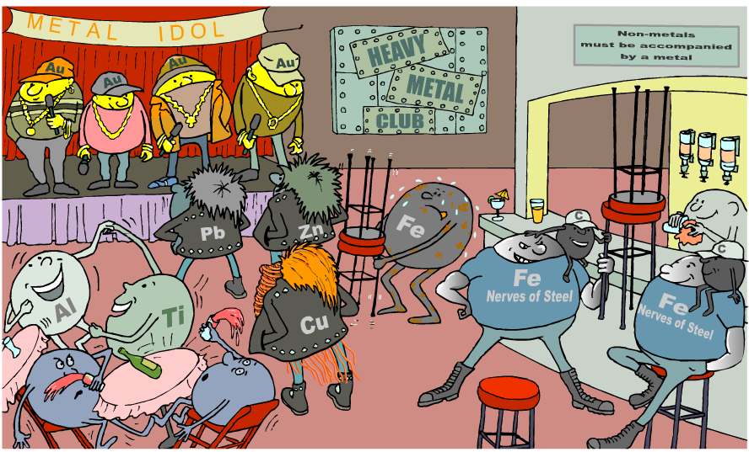
What are the properties of different metals?

Slide 3

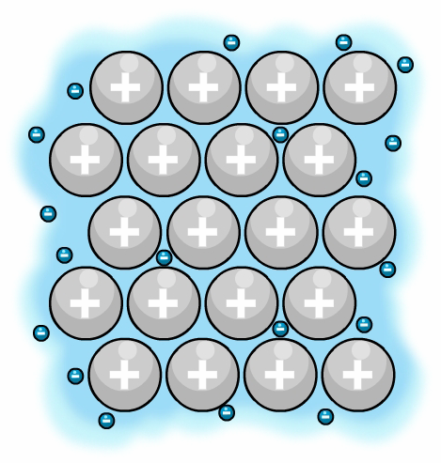
Metallic Structure
sea of electrons
Think of a metal as lots and lots of positive ions stacked together very tightly.
The ions line up and have a “sea of electrons” surrounding them which maintains their bonds and stops them from repelling.
metal ions

Slide 4

How does the sea of electrons affect the properties of metals?
explain why…
Metals conduct heat and electricity
Metals are strong and malleable
Metals have high melting and boiling points

Slide 5
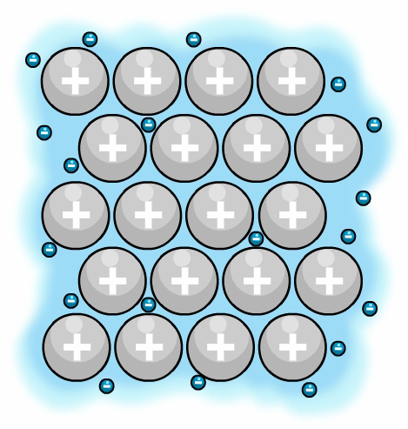
How do metals conduct heat and electricity?
Delocalized electrons in metallic bonding allow metals to conduct heat and electricity.
For example, when a metal is heated, the delocalized electrons gain kinetic energy.
These electrons then move faster and so transfer the gained energy throughout the metal.
This makes heat transfer in metals very efficient.
Delocalized electrons also conduct electricity through metals in a similar way.
heat

Slide 6
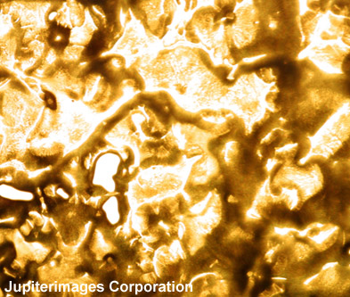
Why do metals have high melting points?
The properties of metals are related to their structure.
Metals often have high melting points and boiling points. Gold, for example, has a melting point of 1064 °C and a boiling point of 2807 °C.
This property is due to the strong electrostatic attraction between the positively-charged metal ions and the sea of electrons.
In metal extraction and other industrial processes, furnaces often run continuously to maintain the high temperatures needed to work with molten metals.
Notes:
Photo credit: © 2006 Jupiterimages Corporation
Molten gold.

Slide 7
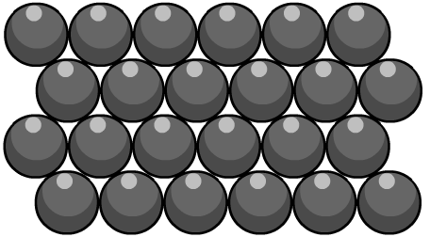
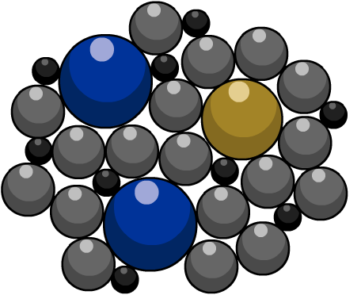
Why is steel stronger than iron?
The atoms in pure iron are arranged in densely-packed layers. These layers can slide over each other. This makes pure iron a very soft material.
The atoms of other elements are different sizes. When other elements are added to iron, their atoms distort the regular structure of the iron atoms.
It is more difficult for the layers of iron atoms in steel to slide over each other and so this alloy is stronger than pure iron.
This is called an Alloy

Slide 8
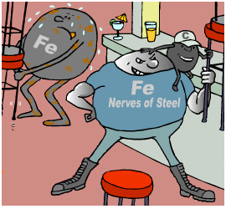
What types of steel are there?
Steel can contain up to 2% carbon.
Varying the amount of carbon gives steel different properties. For example, a higher carbon content makes a hard steel.
Different types of steel are classified
by how much carbon they contain.
low carbon steel contains less than 0.25% carbon
high carbon steel contains more than 0.5% carbon.
Two other important types of steel are:
stainless steel – an alloy of iron that contains at least
11% chromium and smaller amounts of nickel and carbon
titanium steel – an alloy of iron and titanium.

Slide 9
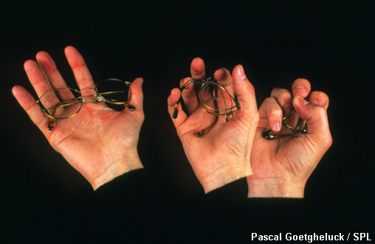
What’s so clever about smart alloys?
A smart material can change one or more of its physical characteristics under the influence of an external stimulus.
Shape memory alloy is a type of smart material made from metals that returns to its original shape after being deformed.
Nitinol is a type of shape memory alloy made from nickel and titanium.
This material can be used to make a pair of glasses that ‘remembers’ its shape and does not break when crushed.
Nitinol has also been used to hold badly broken bones
in place while they heal.
Notes:
Photo credit: Pascal Goetgheluck/Science Photo Library
Memory metal glasses. Time-lapse image of a hand crushing spectacles made from shape memory metal. Memory metals are alloys made from nickel and titanium along with aluminium or copper. Once manufactured in a certain shape the metal may be deformed with little effort, but will quickly regain its shape once released. At room temperature the metal is plastic, so it can return to the structural arrangement in which it was made. This makes the glasses almost unbreakable.

